Slide 1
Group Brainstorm

Slide 2
Combine (wander off)Thermal camera + (identifying) camera scan barcode(tag)RFID
Use a cheaper location tracker (radio wave), combine with thermal imaging.
Drone + image recognition.

Slide 3
Stakeholders
Primary
Sheep owners in the rural town of Rosedale, Mthatha
Shepherds
Secondary
Sheep
Governments
Small business(the GSU student brought this up but I don’t think this is necessary)

Slide 4
Scope
Cost efficient, easy to use solution to track (do we want to know the activity history as well?) the exact location of the sheep once lost in two situations: when sheep wander off by themselves within 1-2km from the homestead or when they got mixed up with sheep from others(5km). The purpose of this product is to help the farmers find their lost sheep without needing to go out search the vicinities and the other homesteads.
Assumptions:
Rotational grazing, rotate at most once per day. (The sheep will not move during the day.)
Budge profit estimation (Tab could you do this?)

Slide 5
Requirements
Most important - Cost efficient / Affordability
Criteria: Design must fall within the budget (do you know what is the estimated budget? @Yiqun) provided, should not exceed the current costs that wandering sheep currently invoke
Metric: $ spent on parts and stuff, compared to how much money is lost from sheep wandering off
Constraint: Should contact stakeholders to get an exact budget, need to know how many sheep wander off
The strict profit sheep make would be ≈ 3000 rand * 0.655 ≈ 2000 rand
# of sheep ≈ 150/owner (double check)
"Reported rates of small livestock loss to predation range from 3-13% and 0.5-19% from communal farming areas"
Minimum loss: 4.5 sheep, Maximum loss: 28.5 sheep
Therefore, constraint:
Hard constraint: Must not exceed (R2000 * 28.5 = R57000) / yr
Should not exceed (R2000 * 4.5 = R9000) / yr
Criteria: Design must be cheap to maintain after implementation (Design should be cheap to repair)
Metric: Annual expected repair fees. Max replacement cost?

Slide 6
Cost Efficiency/ Affordability
Requirement | Cost efficiency, Affordability
Metric | South African Rand (R1 ≈ 0.084 CAD)
Criteria | Lower price is preferred
Constraint | Must not exceed R57000 / yr or R380 / sheep / yr Should not exceed R9000 / yr or R60 / sheep / yr

Slide 7
Main functionality requirements:
Identify when sheep are lost
Criteria1: Immediateness of notification
Metric: Time elapse between the perception and the response
Criteria2: Reliability of the notification
Metric: The percentage error of false alert (lower is better)
Locate the lost sheep
Criteria/metric1: Be able to locate the sheep within 5km
Criteria2: Exactness of the location
Metric: Detect location of the sheep within a radius of 10m (need justify)
Differentiate between different owners
Criteria: Identification must be unique to each sheep
Metric1/Constraint: Must be able differentiate each individual sheep, not just two group of sheep
Metric 2: Identifcation margin of error - The percent error must be no larger than 1% (need to justify)
https://www.researchgate.net/publication/326130661_Food_identification_by_barcode_scanning_in_the_Netherlands_a_quality_assessment_of_labelled_food_product_databases_underlying_popular_nutrition_applications barcodes are 99% accurate
Justification: need an equation to calculate the probability

Slide 8
Requirement | Main Functionality Requirements
Metric | South African Rand (R1 ≈ 0.084 CAD)
Criteria | Lower price is preferred
Constraint | Must not exceed (R2000 * 28.5 = R57000) / yr Should not exceed (R2000 * 4.5 = R9000) / yr

Slide 9
Secondary functionality requirements:
Time efficiency
Criteria: Should take a considerable amount of time when using
Metric: Reaction time/ Time for one use(?) (sec/mins)
Constraint: Less than 30mins (need justify)
Portability
Criteria: Needs to be easy to move around, farmers gotta find their sheep and make sure its theirs or something right.
Metric1: Weight of equipment (kg)
Constraint1: weight requirement: Widget must be under 5.1 pounds (ergonomics, justification)
https://hf.tc.faa.gov/publications/2005-human-factors-guidance-for-the-use-of-handheld/full_text.pdf
Metric2: Size/dimension of the equipment (m^3)
Constraint2: Size requirement: Device should be collapsible to under the dimensions 100x125x255mm(also need to justify)
https://hf.tc.faa.gov/publications/2005-human-factors-guidance-for-the-use-of-handheld/full_text.pdf
Qualitative metric – one shepherd should be able to move the widget without assistance

Slide 10
4. Accessibility/ Ease of use & learning
Criteria 1: local shepherds should be able to understand and use the system
Constraint1: Must be implemented in a system that local shepherds with limited access to technology can use (cite Agorize, they have access to smartphone and Internet, Internet speed, smartphone specs, no computers?)
Constraint2: Must be implemented in the local language (Xhosa), and should also have an English version.
Criteria 2: Should require minimal learning to operate system
Metric: Learning time should be under 2 hours (justify this, cite papers, how to measure ease of learning)
From lecture feasibility: operational feasibility/ease of learning

Slide 11
5. Durability
Criteria: Must be usable for a long period (electrical?)
Metric: lifetime of design/equipment (yrs)
Metric: Energy sources and how long it can work without charge
Battery life,
Criteria: Must be usable in different conditions (metric: hydrophobicity of materials, find a constraint, criteria, etc.)
Constraint: Must past drop test and pressure test (find the tests that are applicable to our designs and prototypes)
Constraint: Past waterproof test since there will be rain outside (likewise)
Constraint: Rustproofing (if there are metal) since conditions are generally wet (find a metric to measure how rustproof the materials are)

Slide 12
Safety (empathy for both the shepherd and the sheep)
Criteria: Must be safe for the shepherd/farmers to use (cite papers, find all different possible hazards imposed on workers/humans/shepherds)
Metric: Number of sharp corners, amount of voltage and current that is used by the widget (better to find a number and justify)
Criteria: It should be able to attached to a sheep easily and painlessly
Metric: Number of sharp corners, amount of voltage and current that is used by the widget, if it emits a sound it shouldn’t harm the sheep, time it takes to attach it to a sheep
Constraint: No electrical component is exposed to the outside due to rainfall

Slide 13
Requirement | The solution should be safe for the farmers/shepherds to use
Metric | 1) The amount the tape is cut in the shard edge test 2) The amount of current used by the widget 3) The amount of voltage used by the widget
Criteria | 1) Lower is preferred 2) Lower is preferred? 3) Lower is preferred?
Constraint | 1) Must be less than 13 centimeters 2) Must be lower than the current circuit elements can handle 3) Must be lower than the voltage circuit elements can handle
Source: https://www.law.cornell.edu/cfr/text/16/1500.49

Slide 15
Organizing ideas from Diverge I
Visual tracking ideas
1) Heat seeking/thermal imaging cameras
2) Drone surveillance
3) Robotic dog
4) Object detection on sheep (Image recognition)
Individual sheep tracking ideas
5) RFID ear tag
6) Solar powered GPS tracker
7) Ringer/wearable device that rings when trying to locate sheep
Non technical ideas
8) Containing the sheep in certain areas
9) An object that gets the attention of the sheep
10) Raise the salary of the shepherds with the budget
11) Sheep link app Bluetooth
12) Make use of a noise at a certain pitch that only sheep can hear
13) Code scanning – Identify Sheep
14) Radio necklace – Realize losing sheep + it can make sounds to help locate

Slide 16
Converge I – Multivoting, 7 ballots
Visual tracking ideas
1) Heat seeking/thermal imaging cameras 👍👍AEYT
2) Drone surveillance EY
3) Robotic dog
4) Object detection on sheep (Image recognition) 👍AATTYE
Individual sheep tracking ideas
5) RFID ear tag 👍T
6) Solar powered GPS tracker TYE
7) Ringer/wearable device that rings when trying to locate sheep ET
Non technical ideas
8) Containing the sheep in certain areas
9) An object that gets the attention of the sheep
10) Raise the salary of the shepherds with the budget
11) Sheep link app Bluetooth E
12) Make use of a noise at a certain pitch that only sheep can hear
13) Code scanning – Identify Sheep 👍YY
14) Radio necklace – Realize losing sheep + it can make sounds to help locate 👍👍TAYE

Slide 17
Converge I Casting the votes
1. Object detection on sheep (image recognition) – 7 votes (Arielle)
2. Heat seeking/thermal imaging cameras – 6 votes (Ethan)
3. Radio necklace – 6 votes + Ringer for locating sheep – 2 votes (TK)
4. RFID ear tag – 3 votes + Code Scanning to identify sheep – 2 votes (Emre)
5. Solar powered GPS Tracker – 2 votes(Yiqun)

Slide 18
Orgnizing Ideas
Identify sheep
1) Code scanning
2) Ringer
Realize a lost sheep
3) Radio necklace
Prevent from lost

Slide 19




1. Infrared/temperature
Heat seeking cameras that distinguish between the internal temperature of the sheep and its surroundings
https://partner.sciencenorway.no/drone-technology-forskningno-norway/drones-help-find-lost-sheep/1429058
Internal temp of a sheep: 38.6 degrees
Average temp of Mthatha: 18.6 degrees with a maximum of 29 degrees in Jan and Feb
A laser sensor that alerts the shepherd if anything goes over the line can also catch predators when they enter the grazing area

Slide 20
RFID tracking-driven
Cost Budget < Profit each sheep makes * sheep they lose
Identify each sheep
Locate?
https://wlius.com/telematics-gps-devices/rflink-rfid-gps/ (reference design)
Sheep: RFID ear tag, remoter shepherds or owner

Slide 21
Sheep Link – (prevention-driven)
Use Bluetooth to exchange random generated codes (Reference design Covid Alert)
If any sheep is away from the group the Bluetooth connection will be lost, then will record the last time and location of the sheep
Blue tooth use short range radiowaves

Slide 22
Scan Sheep (could be either way?)
Use cameras to recognize the sheep group
https://developers.google.com/ml-kit/vision/object-detection this kit provides models that could detect and track objects based on live fed-in videos
If any sheep wanders off, will send an alert, also can capture the direction
Add geography info sensor? Could we get the data for that?

Slide 23

















Notes:
Doesn't address the issue if sheep get mixed in with other herds. May need another widget to complement this idea. If it's too hot, this technology won't work well
Notes:
Doesn't track every sheep, expensive, sounds may hurt the sheep
Notes:
Does not address the issue of wandering sheep :(. But helps identify the different sheep for different farmers and tags can be made cheap (scanner not so much)
Scannable code for each sheep, lets farmers identify their sheep
Thermal Imaging camera which can be extended upwards to cover more area
Radio based necklace which connect to device that notifies you when sheep leave a radius. In "locating mode", necklace creates a sound to help locate sheep

Slide 24
IDEA
Drones play as monitor for sheep, owners can see where the sheep wander towards and use the drone to chase for the sheep's location
Solar powered GPS tracker, use on every sheep and owners can find their sheep on their phone
Robotic dog, when sheep wanders off, the dog will follow with the sheep and the owner can find their sheep based on the location of the robotic dog

Slide 25
Method to prevent sheep from lost
Maybe contain the sheep in certain areas
based on sheep's traits?
Find something that always absorb the sheep's attention?

Slide 26
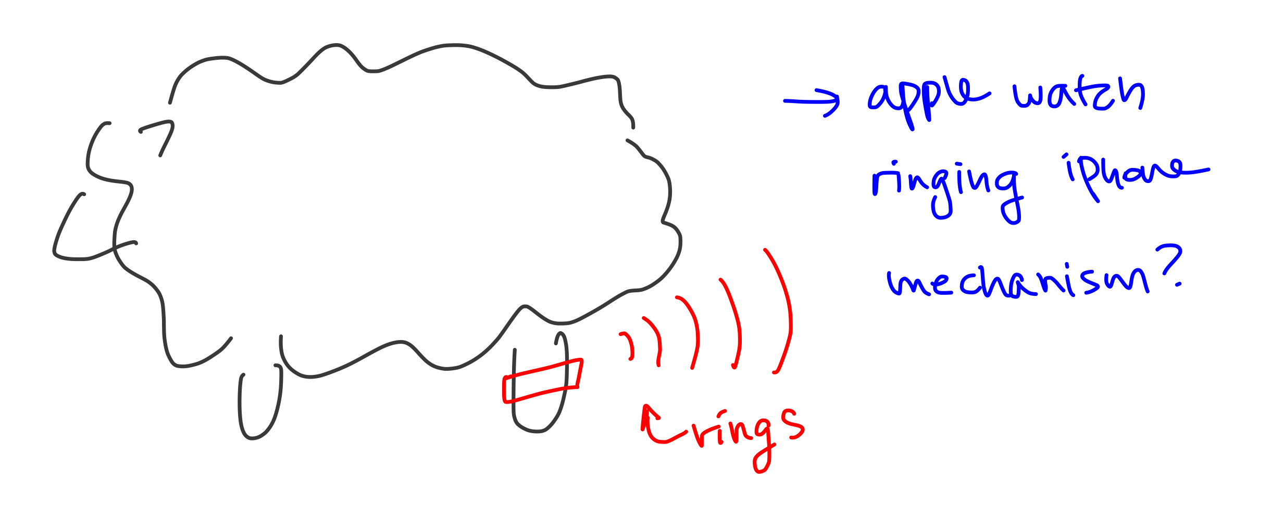
Ringer
Ringer on sheep
Projects a loud noise unique to each owner
Rings either when the owner turns it on (when they can't find them) or once it gets too far from the shepherd or a certain object/place
The shepherd can hold something to be the measurement point (?) to see how far away sheep are
Should be on the cost efficient side since no need for GPS, all you need is a trigger for sound?

Slide 27
Broad Ideas
Surveillance cameras at communal areas + App that will alert once sheep escapes a certain frame or area
Give the shepherds a raise with this budget
Track sheep through emitting radiation...? (requires further research
Make a noise with a pitch that only sheep can hear to control them...? (requires further research)

